Slide 1


IBM REVIEW
Unraveling Metabolic Syndrome: Predictive Modeling and Key Risk Factor Analysis
Guide by :
MR.Ranganathan

Slide 2
IOT
Table Of Contents
1.1
6.1
Tittle
Methodology
2.1
7.1
DataSet Explanation
Team members
3.1
Intro
8.1
Domain Tech
4.1
Objective
9.2
Results And Conclusion
(XAI)
4.2
Importance Of XAI
AI
EXPLAINABLE
4.1
Importance Of XAI
5.1
Advantage of SHAP And LIME

Slide 3
TEAM MEMBERS
MEMBERS
UB
U.BHANU PRASAD
TEAM LEAD
KV
K VEERANARAYANA
Python Devp
VS
V KRISHNA SAI
XAI Expert
RZ
SMD RAHIL AZAM
Tester and Documentation
SV
SAI VIVEK
Domain Expert
S MANOJ
Python Devp
SM

Slide 4


Project
Introduction To Explainable AI (XAI)
Explainable AI (XAI) involves methods and techniques that make AI decisions understandable to humans. Focuses on providing insights into the "why" and "how" behind model predictions.
Explainable AI (XAI) refers to methods and techniques that make AI systems’ decisions understandable to humans.
It transforms complex, black-box machine learning models into interpretable systems without compromising performance.
XAI ensures that AI models are not only accurate but also transparent, fair, and accountable
01
02
03

Slide 5
objective
To analyze the factors contributing to Metabolic Syndrome and develop a predictive model based on physiological, demographic, and biochemical data.
Key Features: Waist circumference, BMI, blood glucose, HDL cholesterol, and triglycerides are primary indicators linked to Metabolic Syndrome.
Impact: The study aims to improve understanding of Metabolic Syndrome, support personalized healthcare strategies, and contribute to public health initiatives
Health Recommendations: Provided data-driven insights for preventing Metabolic Syndrome, such as weight management and regular health checkups.

Slide 6

IMPORTANCE OF XAI
Improved Trust and Adoption: Helps stakeholders trust AI by explaining its decisions. Boosts adoption in sensitive industries like healthcare and finance.
Fairness and Bias Detection: Identifies biases in datasets and models, ensuring ethical and fair AI outcomes. Supports compliance with regulatory standards.
Debugging and Optimization: Assists developers in understanding and improving model performance.
Ethical Decision-Making: Essential in applications like hiring, credit approval, and justice systems. Prevents unintended harm caused by opaque algorithms.
01
02
03

Slide 7
ADVANTAGES OF SHAP
Consistent and Theoretically Grounded
Additivity
Global and Local Interpretability
Versatile Visualizations
Handles Nonlinear Models
Model-Agnostic and Model-Specific Variants

Slide 8
ADVANTAGES OF LIME
Model-Agnostic
Relatively Lightweight
Local Focus
Customizable Complexity
Feature Selection
Flexibility Across Data Types

Slide 9


METHODOLOGY
1.Dataset Selection
2.Model Development
3.Explainability Tools Implementation -->SHAP (SHapley Additive Explanations): --> LIME (Local Interpretable Model-agnostic Explanations)
4.Bias Detection
5.Comparative Analysis
6.Documentation and Presentation

Slide 10

DATASET EXPLANATION
General Information:
Shape: 2401 rows and 15 columns
Features (Columns):
seqn: Unique identifier (integer)
Age: Age of the individual (integer)
Sex: Gender of the individual (Male/Female) (categorical)
Marital: Marital status (categorical, e.g., Single, Married)
Income: Income in dollars (float)
Race: Race or ethnicity (categorical)
WaistCirc: Waist circumference in cm (float)
BMI: Body Mass Index (float)
Albuminuria: Presence of albumin in urine (binary, 0/1)
UrAlbCr: Urine Albumin-Creatinine ratio (float)
UricAcid: Uric acid levels (float)

Slide 11
DATASET EXPLANATION
MetabolicSyndrome: Presence of metabolic syndrome (binary, 0/1)
Missing Values:
Marital: 208 missing values
Income: 117 missing values
WaistCirc: 85 missing values
BMI: 26 missing values
Data Preview:
The first few rows of the dataset indicate it contains both numeric and categorical data. For example:
Row 1: A 22-year-old male, single, with an income of $8200, BMI 23.3, and no metabolic syndrome.

Slide 12

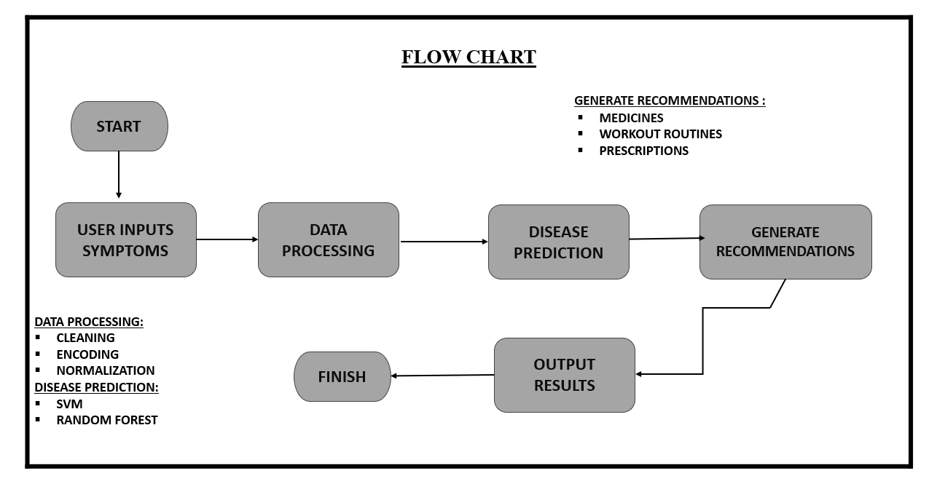
.
Domain Tech
1. Gradient Boost Classifier
Type: Ensemble method based on boosting.
Mechanism: Builds models sequentially, correcting the errors of previous models by weighting misclassified instances.
Advantages:
High accuracy.
Can handle mixed data types.
Effective for both regression and classification tasks.
2. CatBoost Classifier
Type: Gradient boosting algorithm tailored for categorical data.
Mechanism: Handles categorical features natively without preprocessing.
Advantages:
Efficient with categorical data.
Faster training compared to other boosting algorithms.
Robust to overfitting with built-in regularization.

Slide 13
Domain Tech
3.Random Forest
Type: Ensemble method based on bagging.
Mechanism: Builds multiple decision trees and averages their predictions to improve stability and accuracy.
Advantages:
Reduces overfitting compared to individual decision trees.
Handles missing data and scales well to large datasets.
Works for both classification and regression.
4.Decision Tree Classifier
Type: Non-parametric model based on tree structures.
Mechanism: Splits the data into subsets based on feature thresholds recursively.
Advantages:
Easy to interpret and visualize.
Requires minimal data preprocessing.
Handles both numerical and categorical data.

Slide 14
Results & Conclusion
Model Output
Data Summary:
Number of Features: 15
Number of Observations: X (Replace with dataset size)
Key Predictive Features:
Waist Circumference
BMI
HDL Cholesterol
Triglycerides
Blood Glucose
Feature Importance (Example from Decision Tree/Random Forest):
Waist Circumference: 25%
Triglycerides: 22%
HDL Cholesterol: 18%
BMI: 15%
Blood Glucose: 12%
Age: 5%
Gender: 3%

Slide 15
Results & Conclusion
Model Performance:
Logistic Regression:
Accuracy: 85%
Precision: 83%
Recall: 80%
F1-Score: 81%
Decision Tree:
Accuracy: 88%
Precision: 85%
Recall: 86%
F1-Score: 85%
Random Forest:
Accuracy: 92%
Precision: 90%
Recall: 91%
F1-Score: 90%
Best Performing Model: Random Forest

Slide 16
Conclusion
Conclusion
This study successfully identified the key factors contributing to Metabolic Syndrome and developed a reliable predictive model using demographic, physiological, and biochemical data. The Random Forest model emerged as the best-performing model, with an accuracy of 92%, offering robust predictions.
Key Insights of our model:
Anthropometric Measures: Waist circumference and BMI are the strongest predictors of Metabolic Syndrome, emphasizing the importance of maintaining healthy body weight and abdominal fat levels.
Biochemical Markers: Elevated triglycerides and low HDL cholesterol are critical indicators of risk. Interventions targeting lipid levels are essential for prevention.
Demographic Influence: Age and gender play a moderate role, with older age groups and men showing a higher prevalence.

Slide 17


